Slide 1

Bank Loan Case Study
BY. Prajwal pachare

Slide 2
Description
The project aims to address a critical challenge faced by a finance company specializing in urban lending: identifying trustworthy loan applicants with limited credit history while minimizing the risk of defaults. Customers with insufficient credit history often pose a higher risk, yet rejecting them outright might result in lost opportunities for capable borrowers. Through Exploratory Data Analysis (EDA), this project will uncover patterns and insights from customer data to enhance the decision-making process. The analysis will focus on identifying key factors contributing to loan defaults and distinguishing them from attributes of applicants who are

Slide 3
APPROACH
To Understanding data because
The data set is very huge.
Understanding what client ask for and prepare roughwork.
To clean data, fil null values, deleting columns and converting columns.
Selecting columns according to charts ask for.

Slide 4
Tech-Stack Used
Initially I used MICROSOFT EXCEL 360 to overcome all the challenges. They are usability and accessibility, data organization and cleaning, data exploration and analysis, integration with other tools.

Slide 5
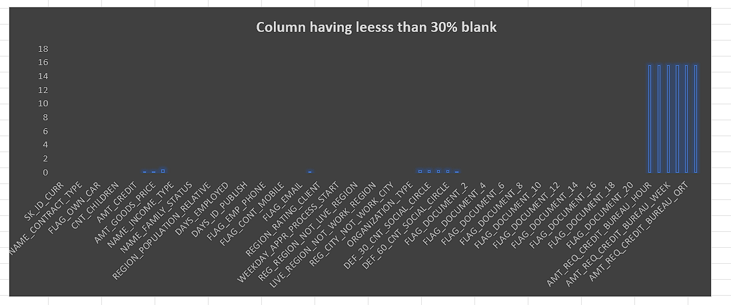
Insights
1. Identify Missing Data and Deal with it Appropriately: As a data analyst, you come across missing data in the loan application dataset. It is essential to handle missing data effectively to ensure the accuracy of the analysis.
In the dataset, there are a total of 122 columns. Out of these, 67 columns contain blank cells. To address this, I decided to remove columns where more than 30% of the cells were blank, as recovering such a significant amount of missing data would be challenging. As a result, I deleted 52 columns from the dataset. For the remaining 15 columns with missing values, I replaced the blank cells with the median value of the respective column It make easy to analyze data.
Column having less than 30% blank values…

Slide 6
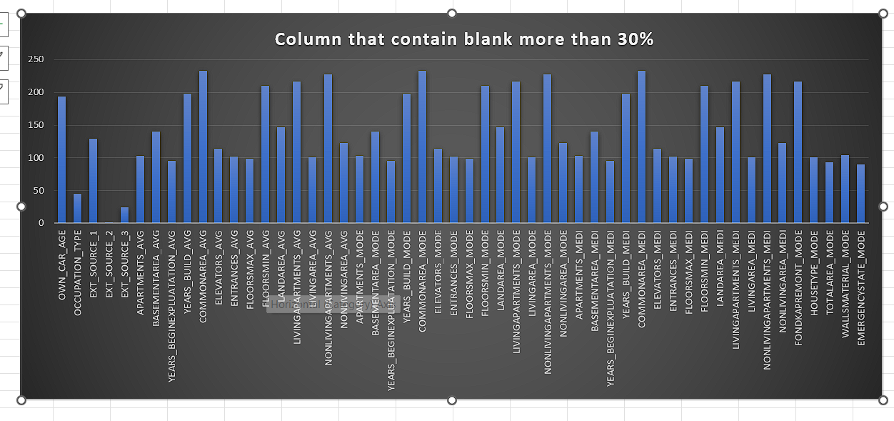
Column having blank cell more than 30%

Slide 7
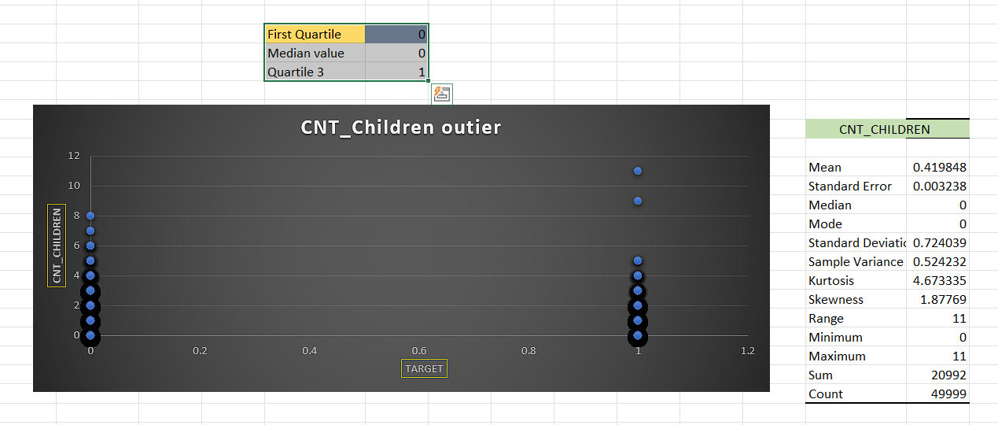
2. Identify Outliers in the Dataset: Outliers can significantly impact the analysis and distort the results. You need to identify outliers in the loan application dataset.
An outlier is a single data point that goes far outside the average value of a group of statistics. It gives unexpected output.
Here, we can see count of children clients have points are ranges between 0 to 6 and more but some client having 11 children that absolutely an outlier it is possible but not in every other case it can change the expected average output.

Slide 8
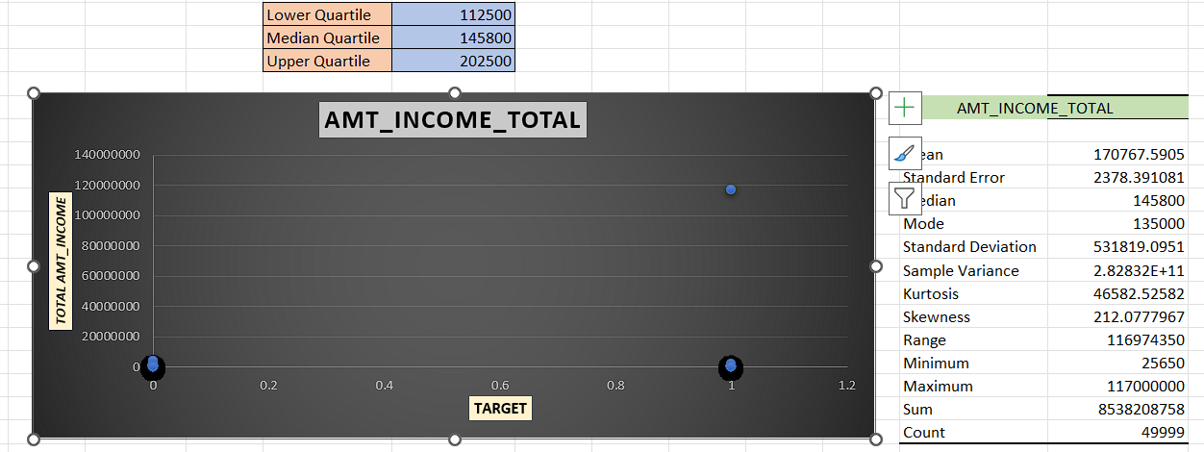
In this case we have total income of clients on x-axis and target on y-axis that shows us all client have total income in between 0 to 20 millions in both scenario who having payment difficulties and who are not having payment difficulties but the one client having total income of 120 millions that might effect on average of total income.

Slide 9
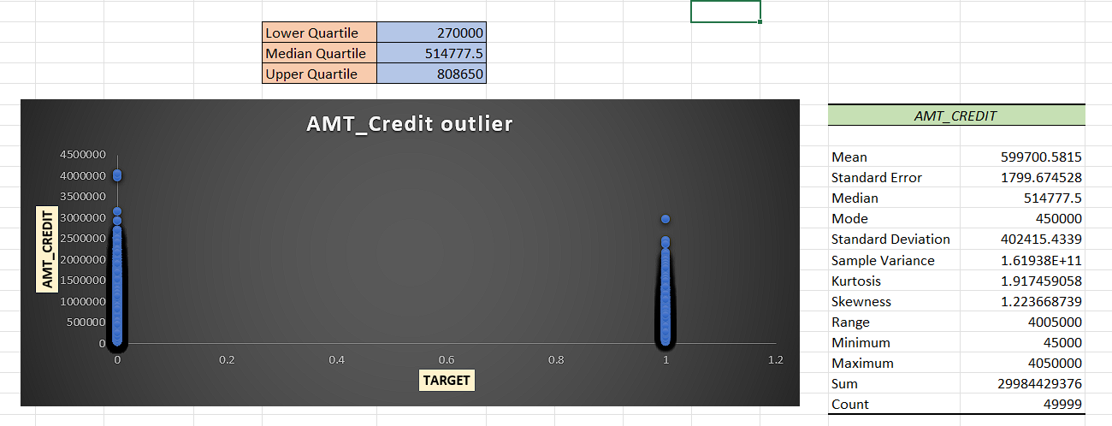
In this scenario we take amount of credit on y-axis and target on x-axis we can see an average points lies in between 0 to 3 Millions on both clients who having payment difficulties and who don’t having payment difficulties but I can see there are some client who having more than 4 millions credit that absolutely an outlier in this case that can change average of credit.

Slide 10
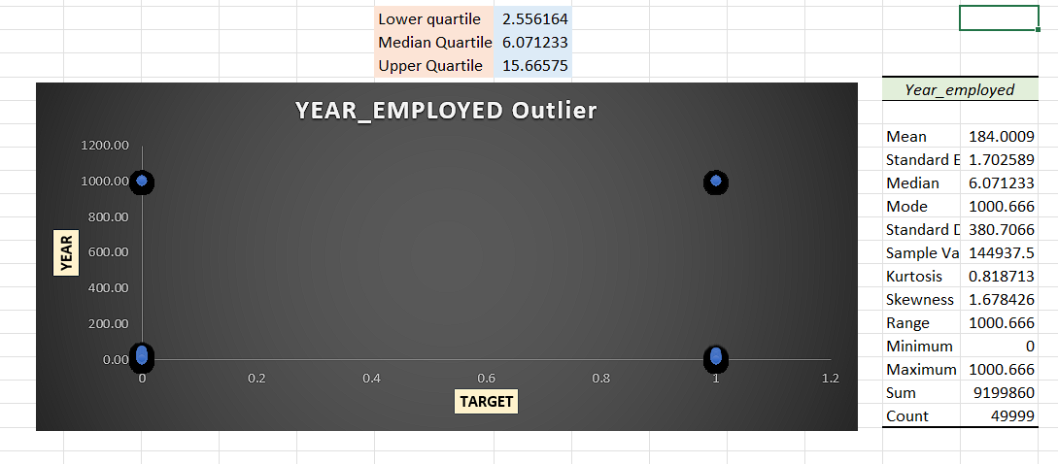
Here, we put year on y-axis and target on x-axis so we can see most of the point lies between 1 to 50 years that is right a human can work in this range but here I can see some client work approx 1000 years that is not possible at all it is definitely an outlier in this case, it might be an technical glitch or human mistake.

Slide 11
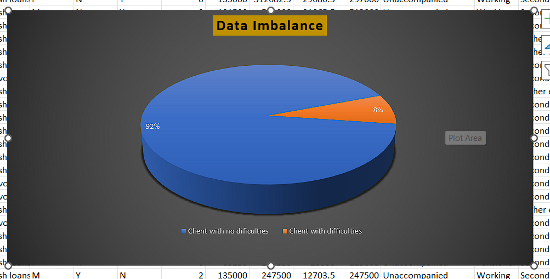
3. Analyze Data Imbalance: Data imbalance can affect the accuracy of the analysis, especially for binary classification problems. Understanding the data distribution is crucial for building reliable models.
Out of a total of 49,999 clients, 92% (45,973 clients) contribute to the bank without payment difficulties, while only 8% (4,026 clients) face payment difficulties. This indicates a significant data imbalance between the two categories of clients. The calculated ratio is approximately 11.32, highlighting that clients without payment difficulties outnumber those with payment difficulties by about 10 times.

Slide 12
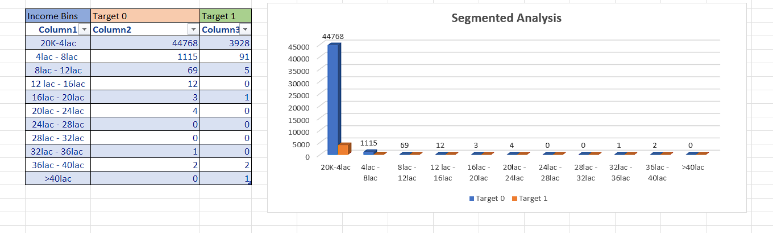
4. Perform Univariate, Segmented , and Bivariate Analysis: To gain insights into the driving factors of loan default, it is important to conduct various analyses on consumer and loan attributes.
In the segmented analysis, we divide the data into two groups: target 0 and target 1. The chart indicates that the majority of clients/applicants with an income between 20,000 to 4 lakh belong to target 0. For target 1, there are 5,000 applicants in this income range

Slide 13
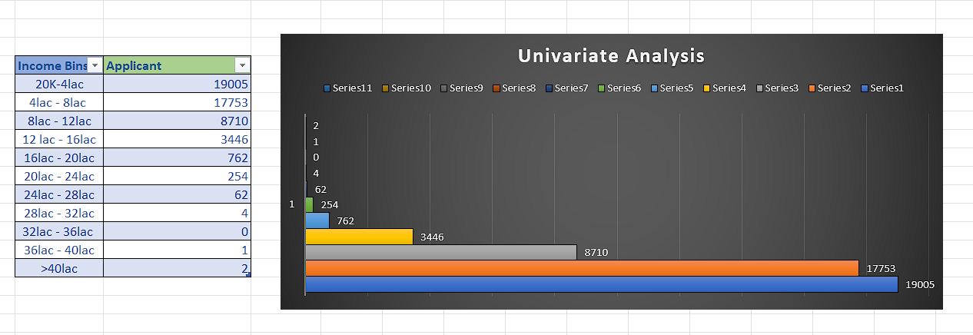
Credit bins
Univariate analysis is a statistical method used to examine a single variable in a dataset. In this analysis, we chose credit bins and applicant data. On the y-axis, we plotted the credit bins, while on the x-axis, we plotted the number of applicants. The analysis revealed that most applicants had credit amounts between 20,000 and 4,00,000.

Slide 14
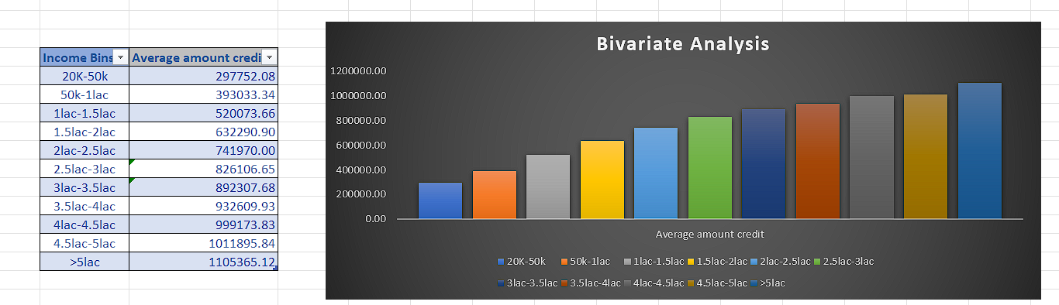
Bivariate analysis refers to the examination of two variables to determine the relationship between them. In this case, we analyze income bins and the average credit. The results show that the highest average credit is observed in the income bin of more than 5 lakh. That mean those having income more than 5 lakh having more credit.

Slide 15
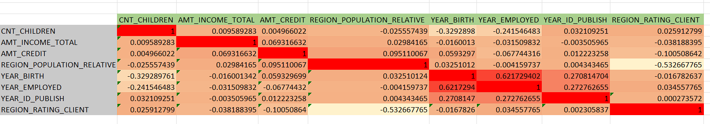
5. Identify Top Correlations for Different Scenarios: Understanding the correlation between variables and the target variable can provide insights into strong indicators of loan default.
Correlation is a statistical measure that expresses the extent to which two variables are linearly related in this I observed column Year_birth and year_employed having highest correlation that is 0.6217 than other if we skip self related correlation.

Slide 16
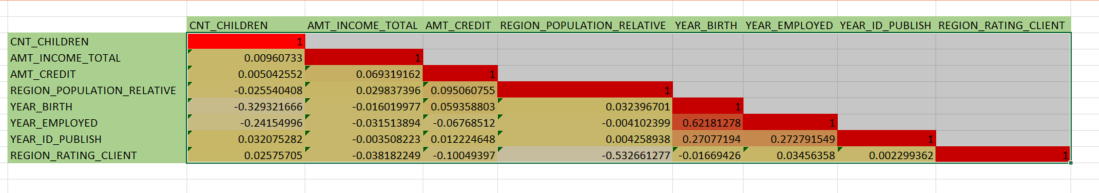
Correlation for Target 1 (Applicants with Payment Difficulties):
The variables year_birth and year_employed have a significant correlation of 0.6218. Additionally, each column has a perfect correlation (1.0) with itself, as expected.

Slide 17
Result
In this project, I gained significant knowledge in the field of finance, particularly in understanding how financial analysis works. I learned about the processes involved, including how data bins are organized in charts and how to apply filters effectively. Additionally, I explored three main analytical concepts: Univariate Analysis, Segmented Analysis, and Bivariate Analysis.

